Slide 1




BrainHack 2024
Detecting ADHD through fMRI signals using machine learning classification models
Team 1:
Covelli, Francisco
Rodriguez, Agustin
Sirne, Ezequiel

Slide 2
Project definition
ADHD: inattention, impulsivity and hyperactivity
5% prevalence rate in Argentina
Diagnosed with subjective clinical criteria that are hard to evaluate
Our objective is to develop ML classification models to detect ADHD through the analysis of resting state functional MRI signals
Covelli, Rodriguez, Sirne - Detecting ADHD through fMRI signals using machine learning classification models

Slide 3
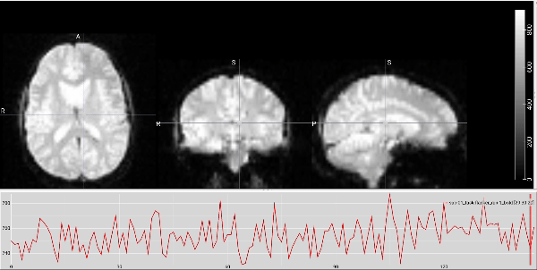
Functional MRI (fMRI)
BOLD Signal (Blood Oxygenation Level Dependent)
“Neurovascular-coupling”
Covelli, Rodriguez, Sirne - Detecting ADHD through fMRI signals using machine learning classification models

Slide 4
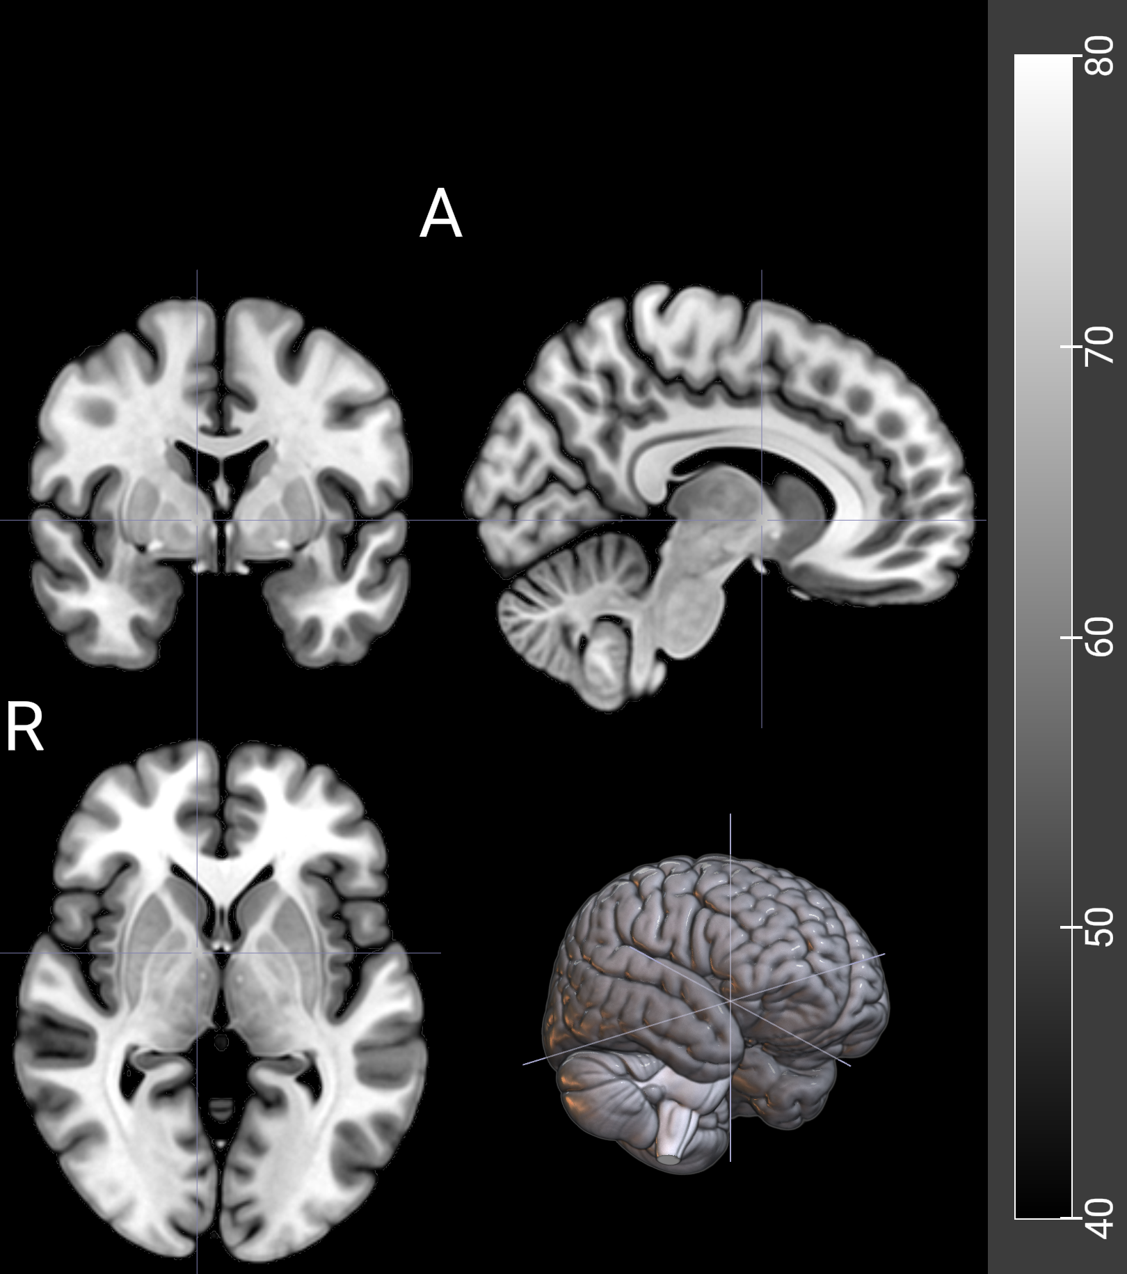
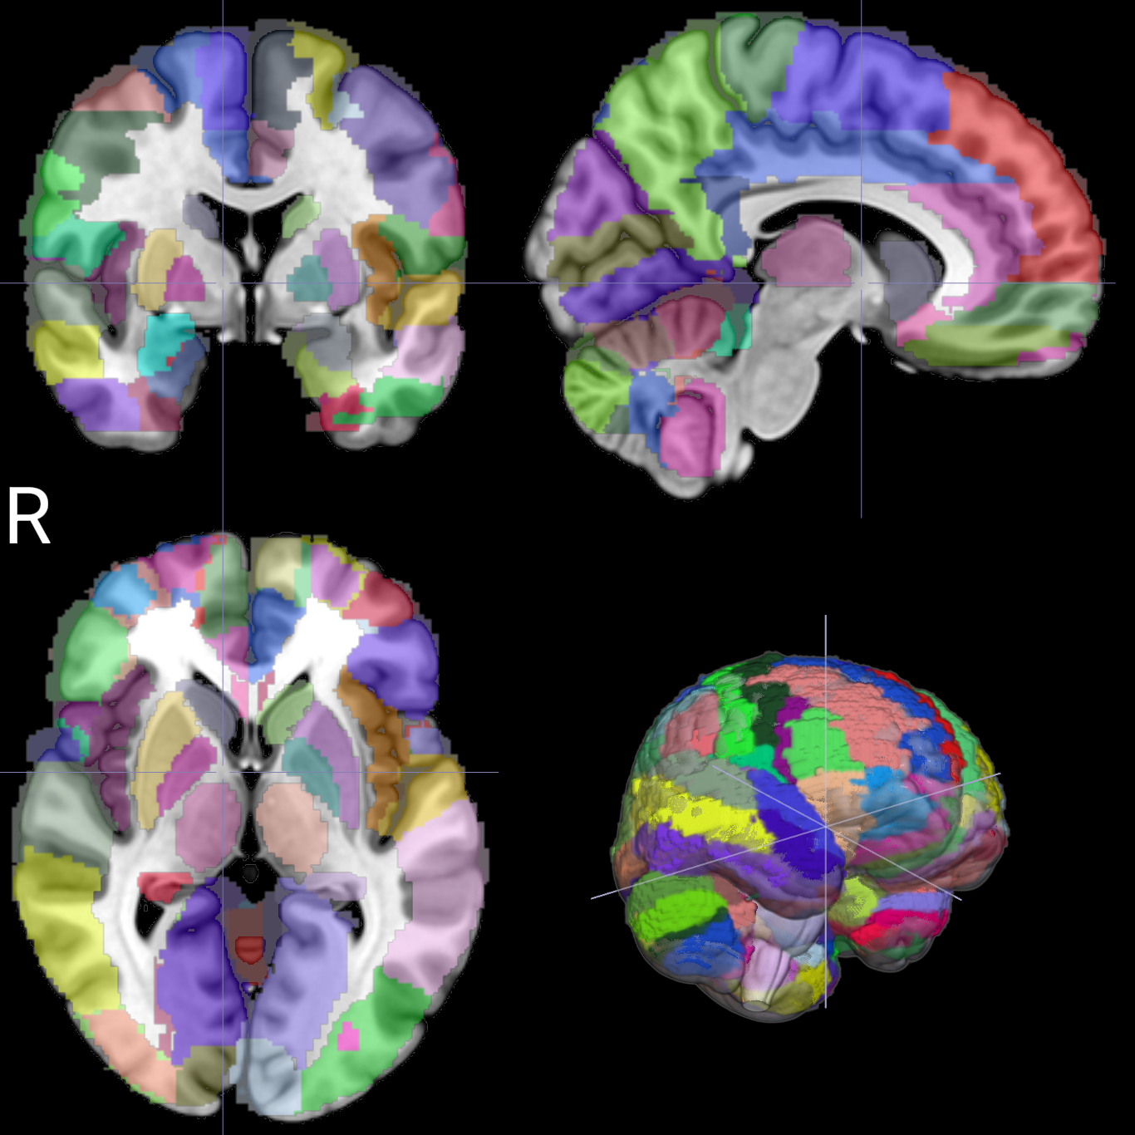
AAL Atlas Visualization with MRIcroGL
Covelli, Rodriguez, Sirne - Detecting ADHD through fMRI signals using machine learning classification models

Slide 5
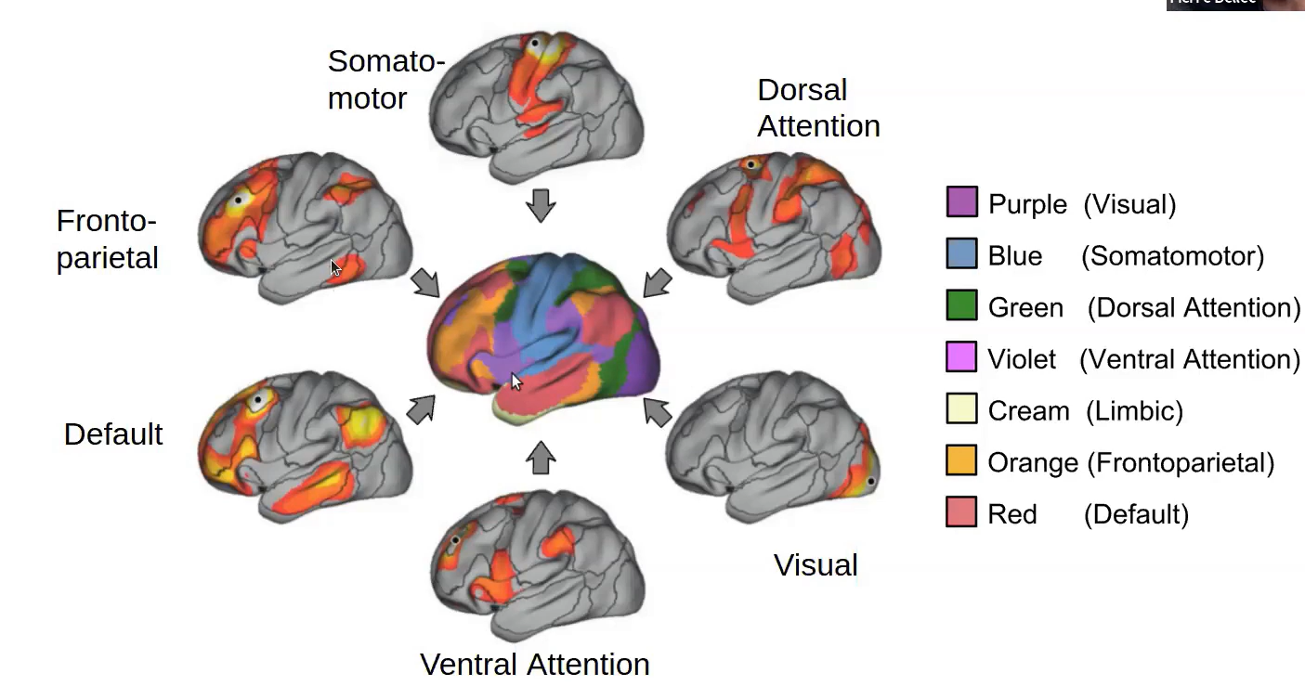
Yeo and Krienen’s 7 clusters - Functional connectivity
Yeo BT, Krienen FM, Sepulcre J, Sabuncu MR, Lashkari D, Hollinshead M, Roffman JL, Smoller JW, Zöllei L, Polimeni JR, Fischl B, Liu H, Buckner RL. The organization of the human cerebral cortex estimated by intrinsic functional connectivity. J Neurophysiol. 2011 Sep;106(3):1125-65. doi: 10.1152/jn.00338.2011. Epub 2011 Jun 8. PMID: 21653723; PMCID: PMC3174820.
Covelli, Rodriguez, Sirne - Detecting ADHD through fMRI signals using machine learning classification models

Slide 6

Dataset Used
ADHD-200 Preprocessed Sample:
Prepared by the collaboration of 8 international neuroimaging institutes, who held a competition in 2011, to identify ADHD biomarkers.
Composition:
947 children and adolescents
362 diagnosed with ADHD
585 typically developing controls
In order to make the competition accessible to a broader range of researchers, the data was preprocessed and shared, what resulted in several publications, MS theses, PhD dissertations and even patents.
s
Covelli, Rodriguez, Sirne - Detecting ADHD through fMRI signals using machine learning classification models

Slide 7
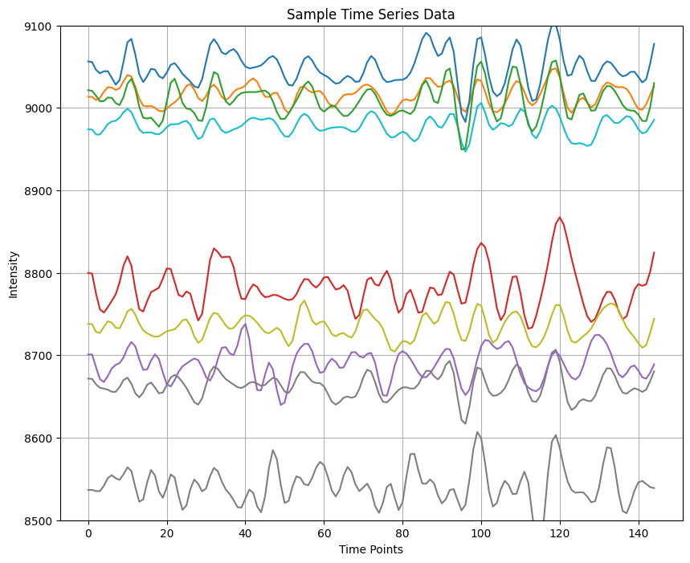

What we extracted from the Dataset:
Each time series represents the intensity of the BOLD signal of every ROI (Region of Interest)
along the rs-fRMI.
In order to create a connectivity matrix, we evaluated the Pearson Correlation between each of these signals.
Covelli, Rodriguez, Sirne - Detecting ADHD through fMRI signals using machine learning classification models

Slide 8
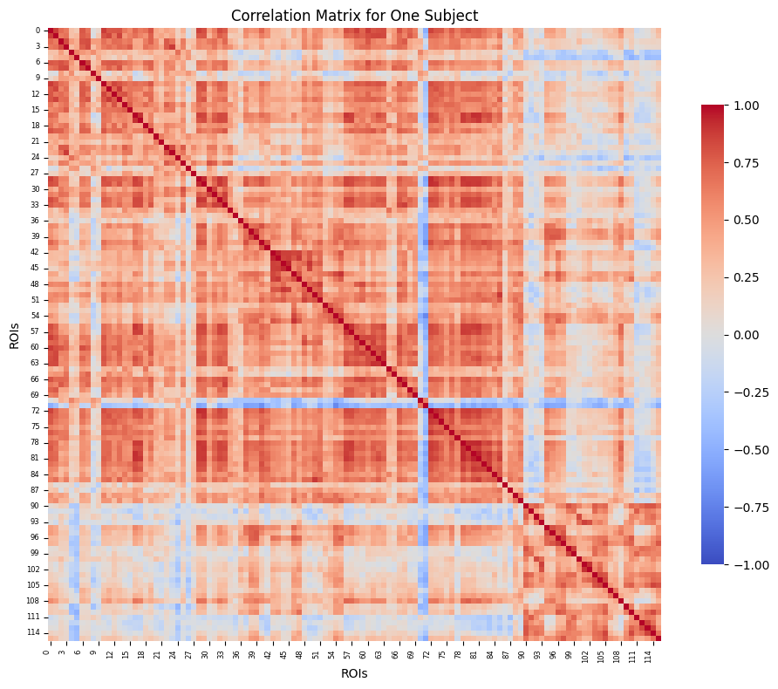


Connectivity or Correlation Matrix:
Covelli, Rodriguez, Sirne - Detecting ADHD through fMRI signals using machine learning classification models

Slide 9
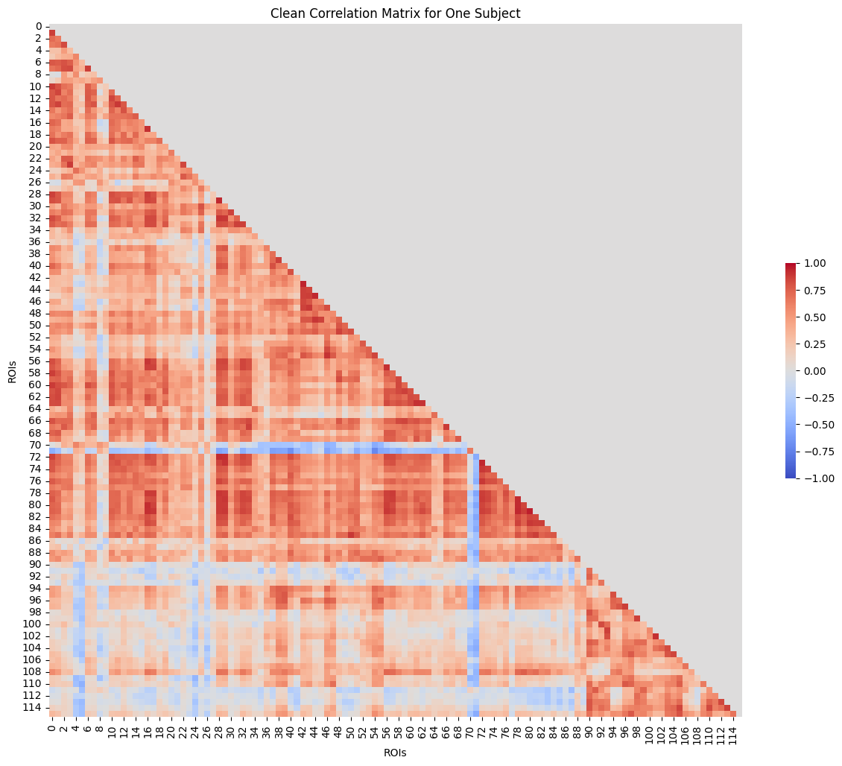
Clean Correlation Matrix and vectorizing:
'Precentral_R x Precentral_L', 'Frontal_Sup_L x Precentral_L',
'Frontal_Sup_L x Precentral_R',
...
'Vermis_10 x Vermis_7',
'Vermis_10 x Vermis_8',
'Vermis_10 x Vermis_9'
This vector stores the Correlation Values of each ROI combination
Covelli, Rodriguez, Sirne - Detecting ADHD through fMRI signals using machine learning classification models

Slide 10


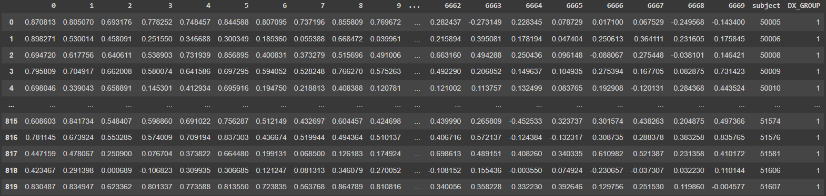
Pipeline:
Covelli, Rodriguez, Sirne - Detecting ADHD through fMRI signals using machine learning classification models

Slide 11

Splitting the DataFrame:
Using train_test_split from sklearn we splitted the data with the following parameters:
test_size=0.2
random_state=42
stratify=target
Covelli, Rodriguez, Sirne - Detecting ADHD through fMRI signals using machine learning classification models

Slide 12

Our Challenge:
Classification problem with a binary target using a Supervised Machine Learning Model.
In the first approach we explore the following models:
a. PCA (Principal Components Analysis)
b. LDA (Linear Discriminant Analysis)
c. Logistic Regression
Covelli, Rodriguez, Sirne - Detecting ADHD through fMRI signals using machine learning classification models

Slide 13


Metrics:
In order to compare the models performances, we used:
Train Accuracy
Test Accuracy
Confusion Matrix
Classification Report, a tool from sklearn.metrics that includes several metrics (such as, precision, recall, f1-score and support)
Covelli, Rodriguez, Sirne - Detecting ADHD through fMRI signals using machine learning classification models

Slide 14

XGBoost:
Since with the previous models we had low accuracy and high overfitting, we studied an ensemble model:
Extreme Gradient Boosting, combines the predictions of multiple individual models to produce a final prediction.
We selected this model hoping that its speed, performance, and versatility could help us reducing the overfitting and get better metrics.
Covelli, Rodriguez, Sirne - Detecting ADHD through fMRI signals using machine learning classification models

Slide 15
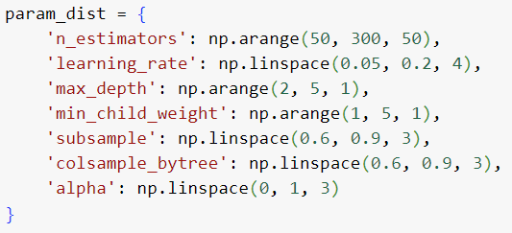
Cross-Validation and Hyperparameters Optimization
Reading XGBoost documentation and using tools like GridSearchCV, Bayesian Optimization and RandomizedSearchCV, we tried several hyperparameters combinations in order to reduce overfitting.
We focused on RandomizedSearchCV since its lower processing cost:
Complexity Control
Randomness
Regularization
Covelli, Rodriguez, Sirne - Detecting ADHD through fMRI signals using machine learning classification models

Slide 16
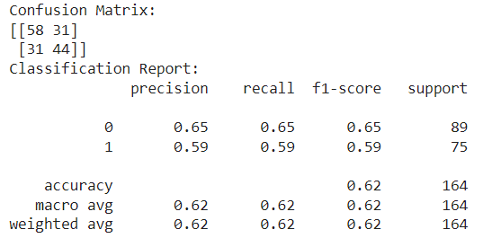
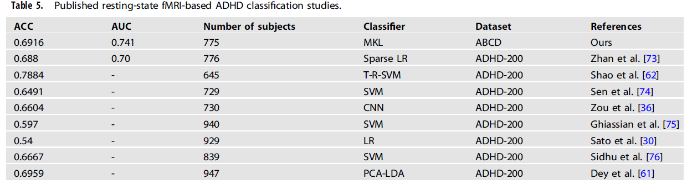
Final Results:
Train Accuracy: 0.9939
Test Accuracy: 0.6219
F1 Score: 0.5867
ROC AUC: 0.6192
Wang et al.
Multiple measurement analysis of resting-state fMRI for ADHD classification in adolescent brain from the ABCD study - Wang et al, 2023
0.6219 0.619 820 XGBoost ADHD-200 Ours
Covelli, Rodriguez, Sirne - Detecting ADHD through fMRI signals using machine learning classification models

Slide 17
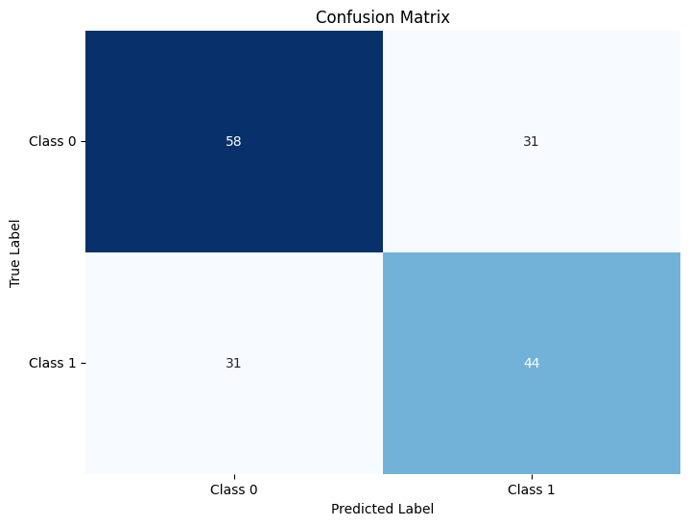
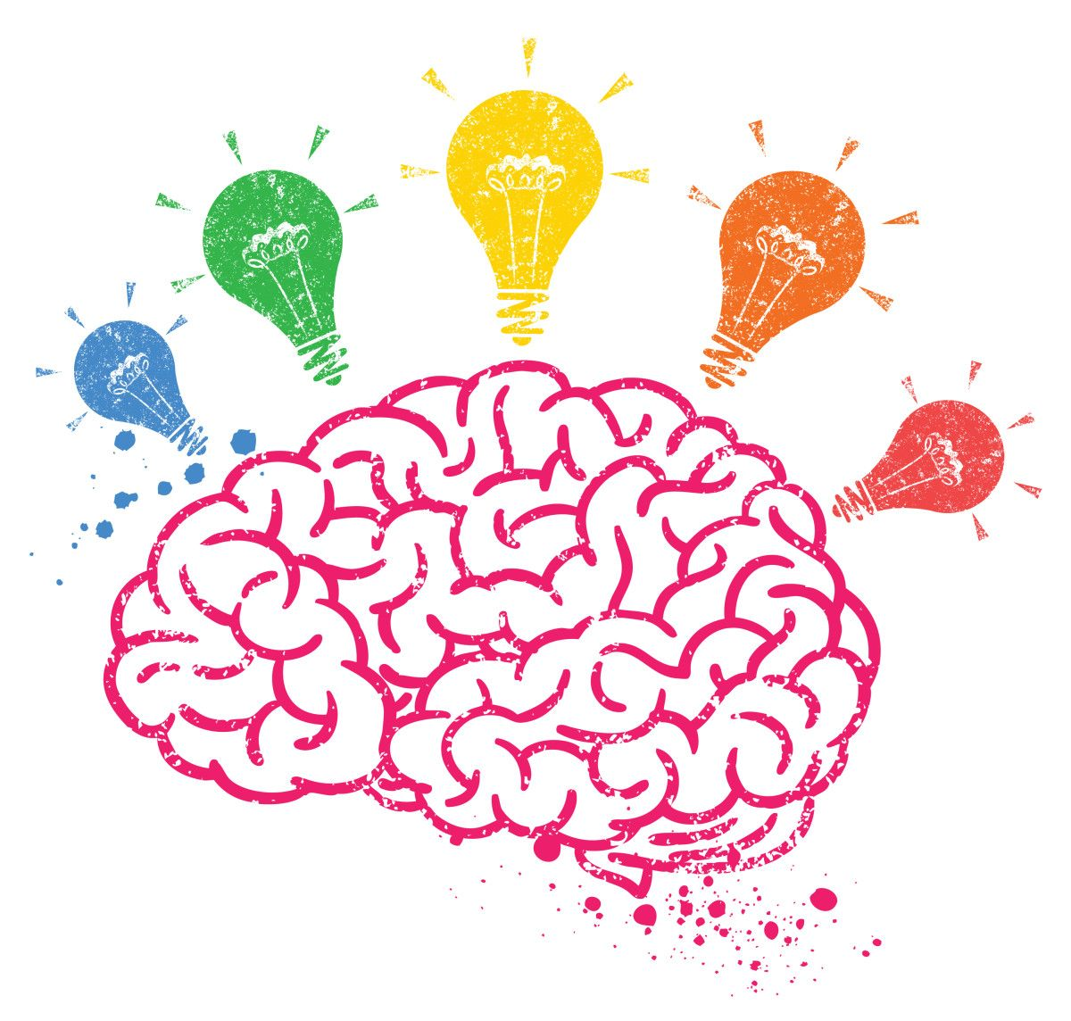
Final Results:
Confusion Matrix
Despite having reduced both Type I and Type II errors, we can conclude that with an accuracy of 0.6219, there is significant room for improvement in ADHD diagnosis based on classification models.
N
58
31
True Label
P
31
44
N
P
Predicted Label
Covelli, Rodriguez, Sirne - Detecting ADHD through fMRI signals using machine learning classification models

Slide 18
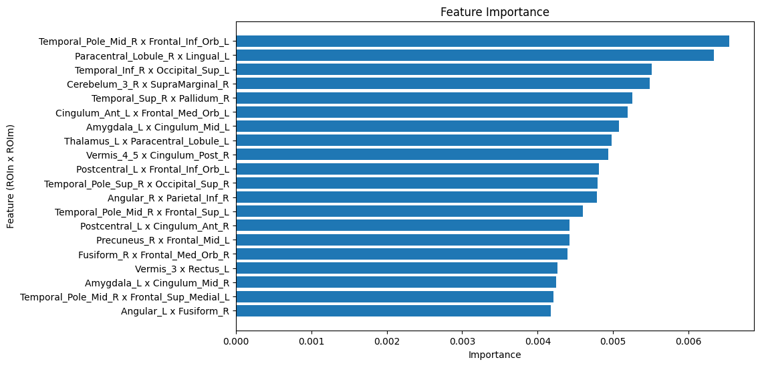
Top 20 Feature Importance & Connectivity Networks ROIs:
Covelli, Rodriguez, Sirne - Detecting ADHD through fMRI signals using machine learning classification models

Slide 19
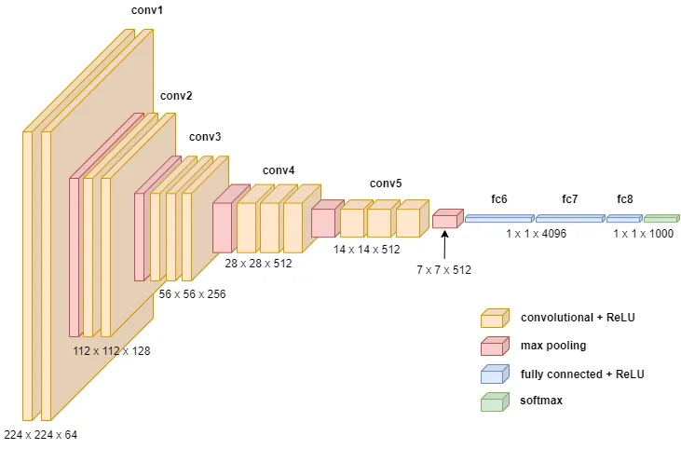
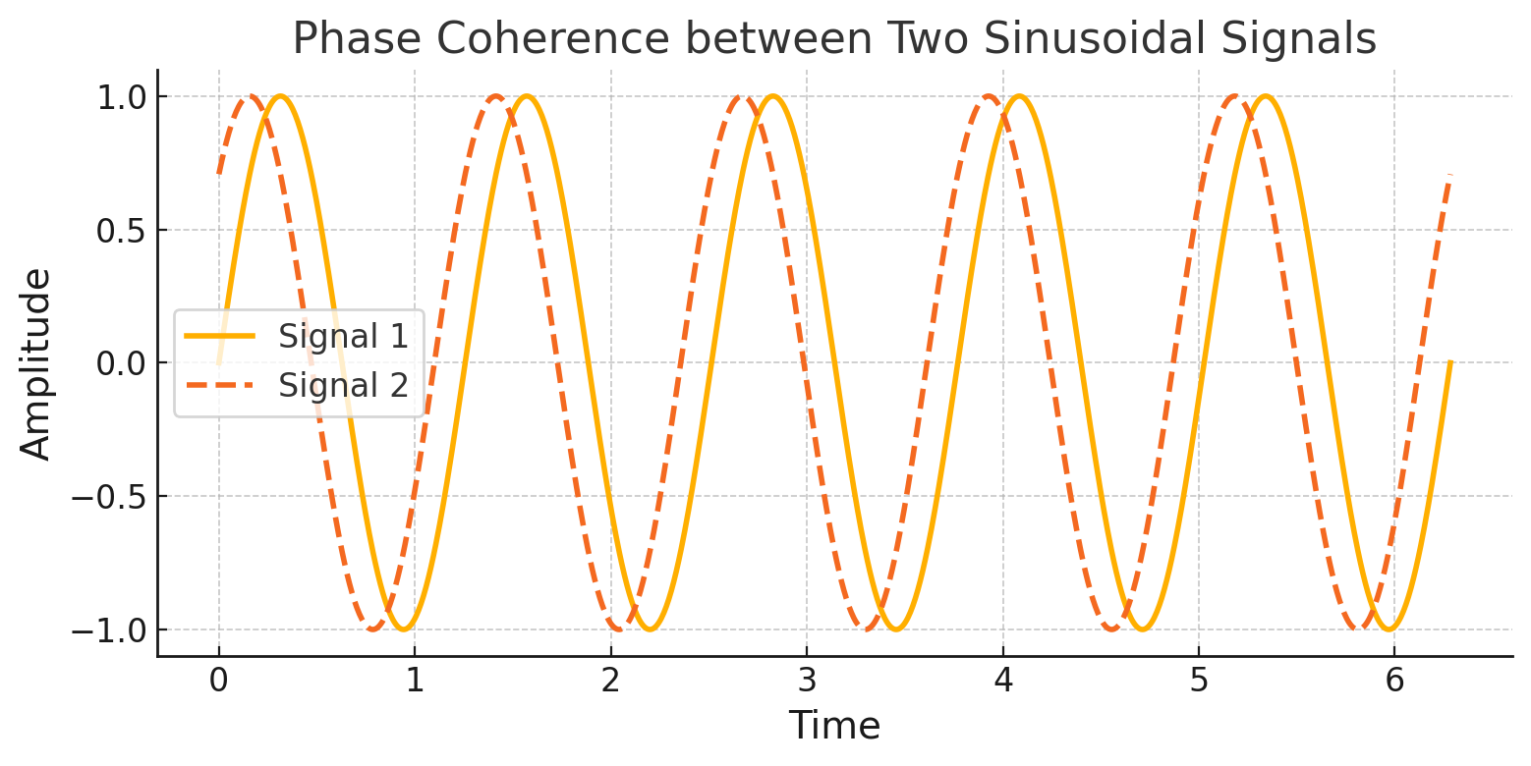
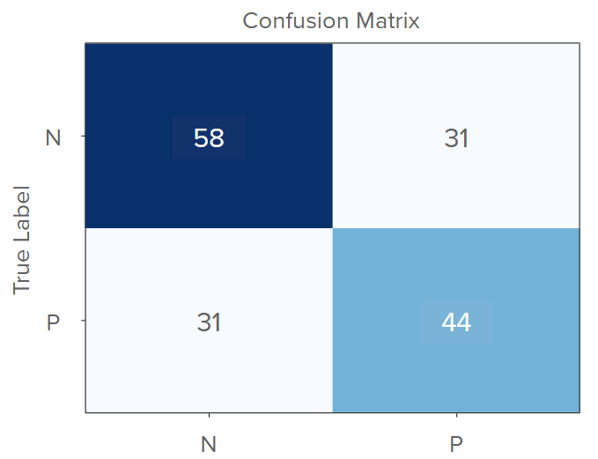
Other possible approaches:
Other features
More complex models
Sensitivity and Specificity
Covelli, Rodriguez, Sirne - Detecting ADHD through fMRI signals using machine learning classification models

Slide 20

Conclusion and acknowledgement
There are many ways to expand and improve this project, and we are excited to explore them.
Finally, we would like to express our gratitude to our teaching assistants from Humai, Buenos Aires, who have supported us from day one and generously shared their diverse expertise in neuroscience and computer science.
Covelli, Rodriguez, Sirne - Detecting ADHD through fMRI signals using machine learning classification models

Slide 21
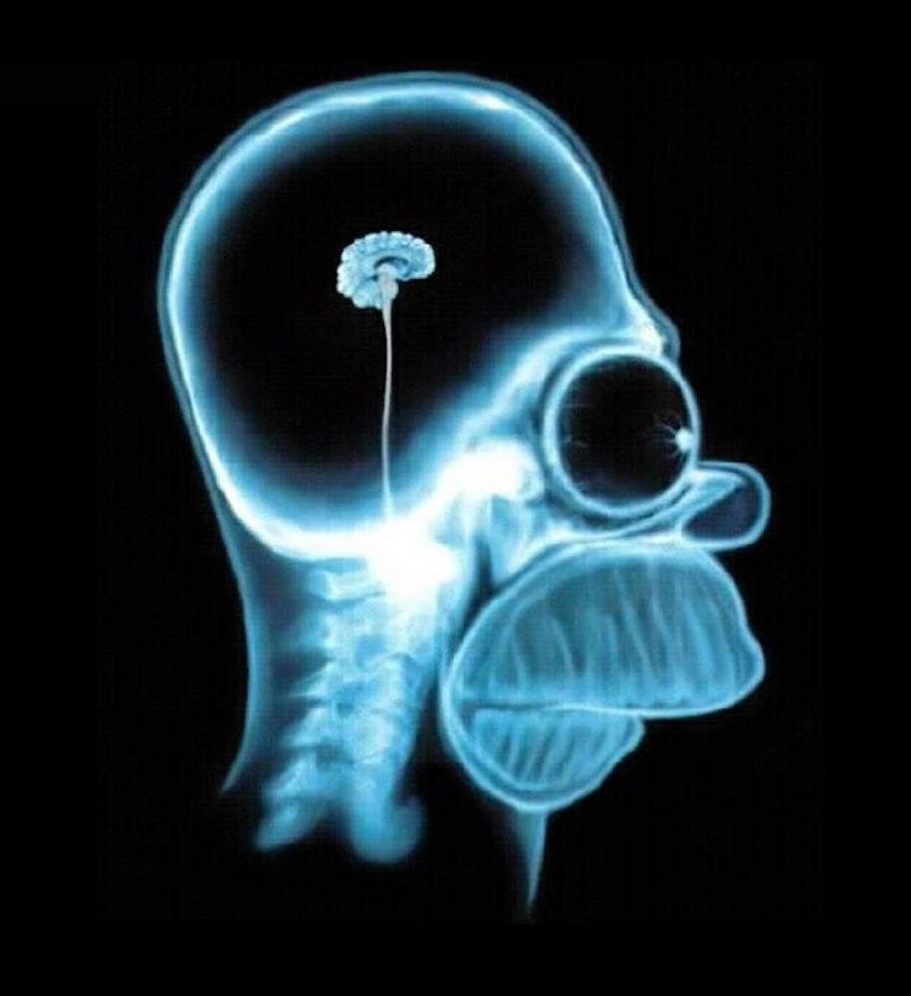
Any questions?
Covelli, Rodriguez, Sirne - Detecting ADHD through fMRI signals using machine learning classification models

Slide 22



Feel free to contact us!
If you need assistance with your artificial intelligence project, we would be happy to help!
Francisco Covelli fcovelli@med.unlp.edu.ar
Agustin Rodriguez
agurodri96@hotmail.com
Ezequiel Sirne
ezequielsirne@gmail.com
Covelli, Rodriguez, Sirne - Detecting ADHD through fMRI signals using machine learning classification models

Slide 23
BrainHack 2024
Thank you for your attention!
Team 1:
Covelli, Francisco
Rodriguez, Agustin
Sirne, Ezequiel

